Slide 1

Data Privacy Workshop

Slide 2
Why is Data Privacy Important to Us?
“Data is the lifeblood of the digital economy and a digital government. We need to use and share data as fully as possible to provide better public services.
…
As the custodian of a vast amount of data, the Government takes this responsibility very seriously. We must do out utmost to minimize the risk of data breaches.
…”
- Prime Minister Lee Hsien Loong, PSDSRC report November 2019

Slide 3
Workshop Schedule
Timeslot | Activity
09:00AM – 09:30AM | Introduction and Terminologies Data Privacy Regulations
09:30AM – 10:00AM | Discussion + Case Study A
10:00AM – 10:30AM | PSDSRC Overview PSDSRC Recommendations 1.1
10:30AM – 10:50AM | Case Study B **5 min break**
10:50AM – 12:00PM | PSDSRC Recommendations 1.2 + Python hands-on
12:00PM – 01:30PM | **Lunch break**
01:30PM – 02:30PM | PSDSRC Recommendations 1.3 + Python hands-on **5 min break**
02:30PM – 03:30PM | Data Anonymization Concepts and methods
03:30PM – 04:00PM | Conclusion + Q&A

Slide 4
Introduction
This presentation was designed to give a quick primer on data privacy concepts and techniques.
In this presentation, we will be covering theory on Data Privacy concepts and techniques as well as practical python examples of how these techniques are done.
Participants are assumed to have some knowledge on basic python programming and have some experience working with data.

Slide 5
What is Data Privacy?

Slide 6
What is Data Privacy?
Data
Privacy
information, especially facts or numbers, collected to be examined and considered and used to help decision-making, or information in an electronic form that can be stored and used by a computer
- Cambridge Advanced Learner's Dictionary
the right that someone has to keep their personal life or personal information secret or known only to a small group of people
- Cambridge Business English Dictionary

Slide 7
What is Data Privacy?
empowering your users to make their own decisions about who can process their data and for what purpose
GDPR, EU
freedom from intrusion into the private life or affairs of an individual when that intrusion results from undue or illegal gathering and use of data about that individual
- NISTIR 8053 ISO/IEC 2382

Slide 8
What is Data Privacy? (In our own words)
Allow users to make decisions on who can process their personal data and for what purpose
Ensure that usage of users’ personal data is limited to the parties and purposes that they have consented to

Slide 9
PII vs Personal Data

Slide 10
Personally identifiable information (PII) vs Personal Data
PII
Personal Data
Personally identifiable information (PII) is any data that could potentially identify a specific individual.
Any information that can be used to distinguish one person from another and can be used for deanonymizing previously anonymous data can be considered PII.
- Tech Target
Any information about an individual maintained by an agency, including (1) any information that can be used to distinguish or trace an individual’s identity, such as name, social security number, date and place of birth, mother‘s maiden name, or biometric records; and (2) any other information that is linked or linkable to an individual, such as medical, educational, financial, and employment information.
- NISTIR 8053 under personally identifiable information GAO Report 08-536, NIST SP 800-122
‘personal data’ means any information relating to an identified or identifiable natural person (‘data subject’); an identifiable natural person is one who can be identified, directly or indirectly, in particular by reference to an identifier such as a name, an identification number, location data, an online identifier or to one or more factors specific to the physical, physiological, genetic, mental, economic, cultural or social identity of that natural person
- GDPR
any information relating to an identified or identifiable natural person (data subject)
- NISTIR 8053 ISO/TS 25237:2008

Slide 11
Personally identifiable information (PII) vs Personal Data (Our definition)
PII
Personal Data
Directly identifying attributes of user (e.g. NRIC, Name, email, mobile number, etc.)
Indirectly identifying attributes that is directly linked to the user (e.g. gender, address, religion, birthday)
any information relating to an identified or identifiable natural person (e.g. any PII, transaction data, web browsing data, geolocation data, etc.)

Slide 12
Personally identifiable information (PII) vs Personal Data
Examples of PII:
NRIC
Name
Age / Birthday
Address
Religion
Examples of Personal Data that are not PII:
Geolocation data
Transaction data
Web browsing data
Personal Data
PII

Slide 13
Data Privacy Regulations

Slide 14
Data Privacy Regulations
Personal Data Protection Act (PDPA), Singapore
IM8 – Data Management and Additional Requirements for the Protection of Personal Data, Singapore Government
*General Data Protection Regulation (GDPR), European Union
* Note: While GDPR has extra-territorial effect (i.e. applies to organizations that handle personal data of EU citizens whether they are EU-based organizations or not), it is rarely applicable to data usage in Singapore public service.

Slide 15
Data Privacy Regulations – PDPA Obligations
Obligation | Explanation
Consent | Only collect, use or disclose personal data for purposes for which an individual has given his or her consent Allow individuals to withdraw consent
Purpose Limitation | May collect, use or disclose personal data about an individual for reasonable purposes which the individual has given consent But may not require the individual to consent for collection, use or disclosure of his or her personal data beyond what is reasonable, as a condition of providing a product or service
Notification | Notify individuals of the purposes for collection, use or disclosure of their personal data on or before such collection, use or disclosure of personal data.
Access and Correction Obligation | Upon request, the personal data of an individual and information about the ways in which personal data has been or may have been used or disclosed within a year before the request should be provided. Requirement to correct any error or omission in an individual’s personal data upon his or her request

Slide 16
Data Privacy Regulations – PDPA Obligations
Obligation | Explanation
Accuracy | Make reasonable effort to ensure that personal data collected is accurate and complete
Protection | Make reasonable security arrangements to protect the personal data that your organisation possesses or controls
Retention Limitation | Cease retention of personal data, or remove the means by which the personal data can be associated with particular individuals, when it is no longer necessary for any business or legal purpose.
Transfer Limitation | Transfer personal data to another country only according to the requirements prescribed under the regulations, to ensure that the standard of protection provided to the personal data so transferred will be comparable to the protection under the PDPA
Accountability | Make information about your data protection policies, practices and complaints process available on request. Designate one or more individuals as a Data Protection Officer to ensure that your organisation complies with the PDPA

Slide 17
Data Privacy Regulations – IM8 equivalent
Obligation | IM8
Consent | Additional Requirements for the Protection of Personal Data - Section 1.5 to section 1.14
Purpose Limitation | Additional Requirements for the Protection of Personal Data - Section 1.15
Notification | Additional Requirements for the Protection of Personal Data - Section 1.16 to section 1.19
Access and Correction Obligation | Additional Requirements for the Protection of Personal Data - Section 1.20 to section 1.28
Accuracy | Additional Requirements for the Protection of Personal Data - Section 1.29
Protection | Policy on Data Management – Section 3
Retention Limitation | Additional Requirements for the Protection of Personal Data - Section 1.30 to Section 1.32
Transfer Limitation | Policy on Data Management – Section 4
Accountability | Additional Requirements for the Protection of Personal Data – Section 1.3
Notes:
PDPA was derived from IM8 and IM8 is actually stricter than PDPA in some aspects.

Slide 18
Links and resources
PDPC website: https://www.pdpc.gov.sg/Overview-of-PDPA/The-Legislation/Personal-Data-Protection-Act
AGC statutes: https://sso.agc.gov.sg/Act/PDPA2012
IM8 (GSIB Intranet): https://intranet.mof.gov.sg/portal/IM/Themes/IT-Management/Data.aspx

Slide 19
Discuss: What are the PDPA Obligations before, on and after collection of personal data?
On or before collection of personal data
After collection of personal data
All time
Consent
Purpose limitation
Notification
Access and correction obligation
Accuracy
Protection
Retention limitation
Transfer limitation
Accountability

Slide 20
Case Study A (15mins)
Agency A owns a set of corporate contact data (office contact and email). Agency B has a project that requires the corporate contact data from Agency A to be shared to Vendor C for further processing.
By reading up the relevant clauses of PDPA and IM8, explain what actions should Agency B take before the sharing of data could be done.
Requests for data
Agency B
Contractual relationship
Agency A
Vendor C
Provides data

Slide 21
Case Study A (potential solution)
PDPA does not apply in this scenario
PDPA Section 4(1)(c): Parts III to VI (of the PDPA) shall not impose any obligation on any public agency or an organisation in the course of acting on behalf of a public agency in relation to the collection, use or disclosure of the personal data
Additional requirements for the protection of personal data does not apply to business contact information
IM8 Additional requirements for the protection of personal data:
The “Additional requirements for the protection of personal data” shall apply to all personal data possessed, controlled, or processed by an Agency except: 1. Personal data of a deceased individual; and 2. Business contact information

Slide 22
Case Study A (potential solution - continued)
Can use Standardised Terms of Sharing (STS) and Standardised Data Sharing Form (SDSF) for sharing data from Agency A to Agency B with explicit authorization for use by Vendor C for the specified purpose.
IM8 Data, 4. Data Access and Distribution, Section 1.4:
Agencies shall adopt the STS when sharing data with another Agency. The STS defines the respective roles and responsibilities of the data provider, data requestor and the data controller. It clarifies that accountability for the data flows with the movement of the data.
IM8 Data, 4. Data Access and Distribution, Section 1.14/G1:
Agencies should consider adapting the STS and/or SDSF when sharing data with Non-Government Entities (NGEs) because the governance principles therein are useful starting points for Agencies to establish the Terms of Use.
Agency B also has to ensure that there are controls in place to govern the handling and processing of data in the form of contractual clauses with Vendor C
IM8 Data, 4. Data Access and Distribution, Section 1.14/G2:
NGEs are not subject to the Instruction Manuals (IM). Apart from the Official Secrets Act, the Statutory Bodies and Government Companies (Protection of Secrecy) Act and other sector-specific legislation which may apply, the primary form of control over NGEs would be in the form of contractual clauses governing the handling and processing of such data.

Slide 23
PSDSRC Report and its Recommendations

Slide 24
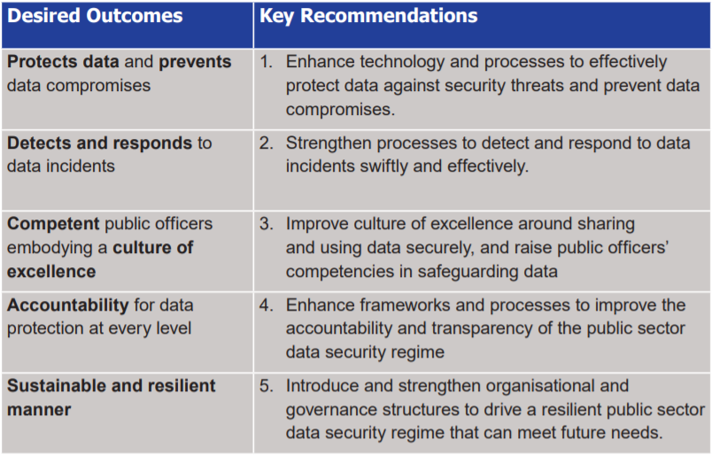
Public Sector Data Security Review Committee (PSDSRC) Report
Comprehensive Report on Data Security Practices in across entire Public Service
Five Key Recommendations
Focus on KR1 as it is directly related to DSAID DE team’s job scope in building data solutions
Do note that there are some safeguards that are more focused on general data protection and cybersecurity, which will not be our main focus for data privacy

Slide 25
Public Sector Data Security Review Committee (PSDSRC) Report
For Key Recommendation 1, to protect data and prevent data compromises:
13 technical safeguards (prefixed with ‘T’)
10 process safeguards (prefixed with ‘P’)
PSDSRC goal is to implement relevant measures for 80% of Government systems by end 2021 and for all Government systems by end 2023

Slide 26
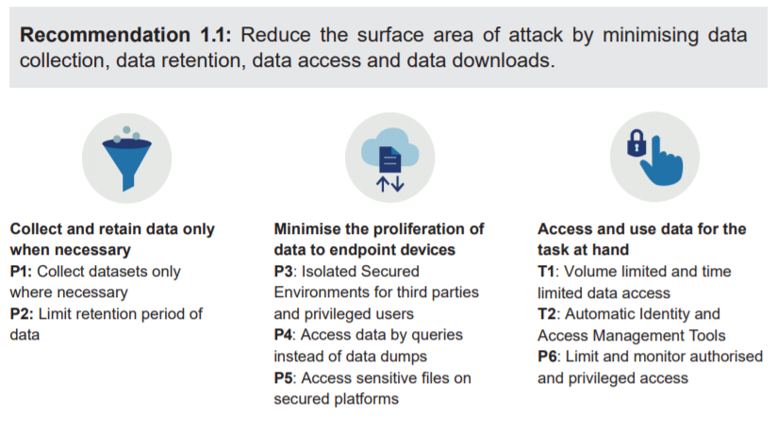

Slide 27
P1 – Collect datasets only where necessary
What:
Reduces the surface area of attack by minimising the collection of datasets that are unnecessary or have no clear identified value for agencies’ operations
Why:
Reduce surface area of attack. Lesser data collected is lesser data to be protected and managed.
How:
Agencies should not collect data that is already collected by Single Sources of Truth as part of the Government Data Architecture. Agencies should obtain such data from the Trusted Centres when needed.

Slide 28
P2 – Limit retention period of data
What:
Reduces the surface area of attack by minimising the storing of datasets at agency or at endpoint devices
Why:
Reducing surface area of attack. Lesser data retained at endpoint devices or other agencies will reduce the amount of data to be protected and managed.
How:
Agencies should set a retention period for each dataset collected. The datasets should be purged from the officer’s laptop after the retention period is over

Slide 29
P3 – Isolated secure environments for third parties and privileged users
What:
Ensures that high-risk users (i.e. users which are entrusted with functions, tasks or data that are highly sensitive) are not able to extract data from Government systems.
Why:
Prevent data leakage by extraction or copying.
How:
Instead of downloading the dataset onto the vendor’s system, the vendor or public officer accesses it through a Virtual Desktop Infrastructure (VDI) which prevents data transfer. The vendor or public officer is able to view the data required, but will not be able to copy out the data.

Slide 30
P4 – Access data by queries instead of data dumps
What:
Reduces the risk that a full database is compromised as only the necessary fields and records are accessed.
Why:
Reduce surface area of attack by limiting data retrieval based on need to basis.
How:
Instead of downloading the whole database with records for all citizens, the officer queries the database and retrieves only the record of the citizen that the officer is serving.

Slide 31
P5 – Access sensitive files on secured platforms
What:
Ensures that access to sensitive files have the appropriate security safeguards and are logged and monitored.
Why:
Prevent data leakage by endpoint devices being accessed by unauthorized users and ensure that logs are monitored for malicious activities.
How:
Instead of downloading data from the database onto his laptop, he should use the collaboration functions of the Singapore Government Document Collaboration Service (SG-DCS) to access data on the platform where feasible. This is the equivalent of accessing data on Google Drive without downloading it onto one’s laptop.

Slide 32
T1 – Volume limited and time limited data access
What:
Prevents officers from accessing too much data at one time, and the duration the officer can access it.
Why:
Access should be limited to relevant datasets, or to a subset of the data so that the data users only have access to the data that is needed to carry out their assignment. This reduces the risk of an accidental exfiltration, or outside attacker gaining access to sensitive data through compromising a data user’s account. This also reduces the risk of an insider accessing sensitive data when he or she is not authorised to do so.
How:
Restrict data access when the duration and volume data access exceeds predefined limits. (e.g. VPN time limit)

Slide 33
T2 – Automatic Identity and Access Management (IAM) tools
What:
Ensures that access to the data is limited only to people authorised to do so.
Why:
Access should be limited to relevant datasets, or to a subset of the data so that the data users only have access to the data that is needed to carry out their assignment. This reduces the risk of an accidental exfiltration, or outside attacker gaining access to sensitive data through compromising a data user’s account. This also reduces the risk of an insider accessing sensitive data when he or she is not authorised to do so.
How:
IAM tools automatically manage officers’ identity and access rights, ensuring that only authorised persons can access data.
Automatic Privileged Identity and Management (PIM) tools control, monitor, and protect user accounts which have more access and capabilities than ordinary users (e.g. administrator accounts) and enforce more stringent measures (e.g. 2FA, time-limited access) to protect these accounts.

Slide 34
P6 – Limit and monitor authorized and privileged access
What:
Reduces the risk that a malicious outsider gains access to an account with access to sensitive data.
Why:
Access should be limited to relevant datasets, or to a subset of the data so that the data users only have access to the data that is needed to carry out their assignment. This reduces the risk of an accidental exfiltration, or outside attacker gaining access to sensitive data through compromising a data user’s account. This also reduces the risk of an insider accessing sensitive data when he or she is not authorised to do so.
How:
Agencies should set strict processes that allow privileged access only where necessary, and ensure access is closely tracked and not shared.
This is enabled by the technical safeguard, T2: Automatic Identity and Access Management Tools.

Slide 35
Case study B (15mins)
Agency A needs to conduct a study of social economic trends and has engaged a vendor to help with the analysis of the data. However, Agency A does not currently have the required data to perform the study.
Make your own assumptions on the attributes of the data (e.g. size, nature, sensitivity, etc.)
Using the applicable safeguards in PSDSRC recommendation 1.1, list and explain measures that Agency A should take to perform this study.

Slide 36
Case study B (Potential Solution)
(P1) If the data required is already collected by Single Sources of Truth as part of the Government Data Architecture, Agency A should obtain such data from the relevant Trusted Centre(s).
(P3) Vendor should only be allowed to do analysis on a Virtual Desktop Infrastructure (VDI) which prevents data transfer. The vendor or public officer is able to view the data required, but will not be able to copy out the data.
(P4) Instead of downloading the whole database for analysis, only the relevant fields and records should be extracted for the purpose of the study.
(T1 and P2) Once the study has concluded, the vendor should not be allowed continued access to the data sets. The data sets provided via the VDI should be purged when it is not required for the study anymore.

Slide 37
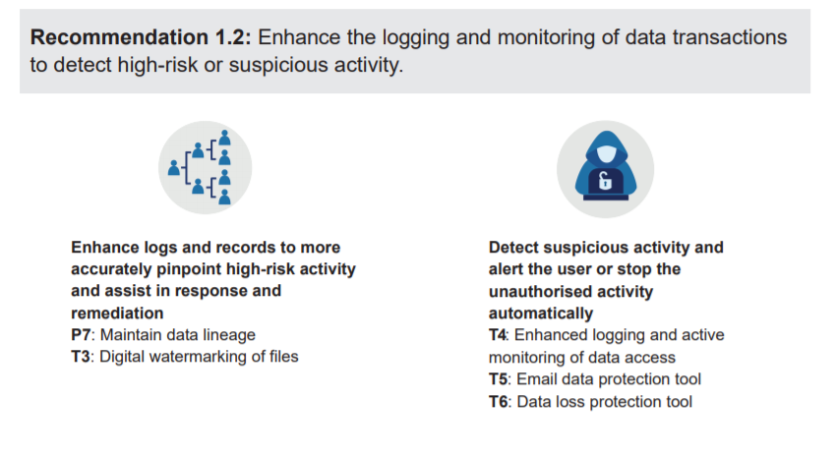

Slide 38
P7 – Maintain data lineage
What:
Identify any unauthorised modification and usage of data flows, and support the remediation of an unauthorised modification to the data.
Why:
Logging and monitoring allows the Government to detect suspicious or high risk activity, and take immediate action to resolve this to prevent data compromises.
How:
By maintaining a record of where the data is used, how the data is transferred, how the data has been changed and who has used the data for what purposes, the agency is able to identify and rectify this unauthorised modification.

Slide 39
T3 – Digital watermarking of file
What:
Enable investigators to trace from whom the dataset originated from in the event of a data incident.
Why:
Logging and monitoring allows the Government to detect suspicious or high risk activity, and take immediate action to resolve this to prevent data compromises.
How:
Adding marking information, such as cryptographic signature. The watermark information can identify the originator of the dataset, prove the authenticity of the file, and is hard to remove from the file.

Slide 40
Digital watermarking of file
Techniques:
Steganography: Hiding information within the file which cannot be easily seen
Cryptographic signatures in file metadata: Embedding cryptographic signatures into file metadata, which can tell us about the integrity of the file and where it originated from

Slide 41

T3 – Digital watermarking of file
Code Demo

Slide 42
T4 – Enhanced logging and active monitoring of data access
What:
Keep logs and analyse them to flag out anomalous activity as well as support remediation in the event of a data breach.
Why:
Logging and monitoring allows the Government to detect suspicious or high risk activity, and take immediate action to resolve this to prevent data compromises.
How:
Logging of data access to sensitive data at greater detail, such as at the individual data query level. The logs should be protected from accidental or deliberate erasure, so that they can reliably show what data has been compromised, how it has been compromised and who was involved.
Active monitoring of data access to sensitive data by proactive scanning of log files for anomalous data access behaviours, and active checking of data access endpoints’ for compliance with data security rules.

Slide 43
T5 – Email data protection tool
What:
Ensures email senders double-check that they intend to send any email with potentially risky activities (e.g. containing sensitive data, or to suspect addressees) to prevent any accidental or unauthorised disclosure through email.
Why:
Prevent any accidental or unauthorised disclosure through email
How:
Email tools which scan for potentially risky activities (e.g. embedded files in file attachments, large numbers of users in cc lists, email content contains identifiers such as NRICs) and require users to positively affirm that they intend to proceed with the potentially risky activities.

Slide 44
T5 – Email data protection tool
Code Demo

Slide 45
T6 – Data loss protection tool
What:
Prevents anomalous activities that are likely to be correlated with malicious activity or data incidents.
Why:
Logging and monitoring allows the Government to detect suspicious or high risk activity, and take immediate action to resolve this to prevent data compromises.
How:
Monitor computer network and files for anomalous activities (e.g. unexpected downloads of large amounts of data to personal computers) and stop any unauthorised file transfers.

Slide 46
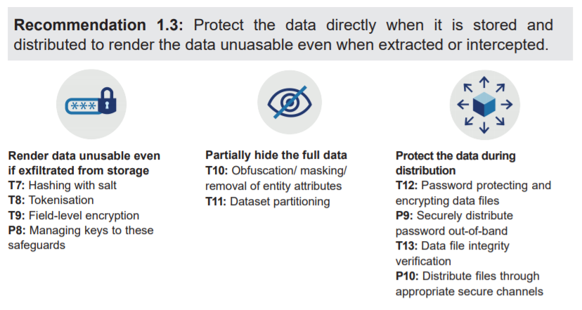

Slide 47

T7 – Hashing with salt*
What:
Ensure that sensitive values (e.g. identifiers) cannot be seen or reasonably recovered in the event of a compromise.
Why:
This ensures that even if an attacker were to break into the IT system, the data would be unusable to the attacker.
How:
Replace sensitive values (e.g. identifiers) with an algorithmically derived value that cannot be reversed easily.
*Note: this measure is only appropriate for data fields where the actual values need not be recovered, such as passwords or for aggregated data analytics. Strong hashing functions should be used, such as cryptographic hash function, that cannot be reversed with current computing resources.

Slide 48
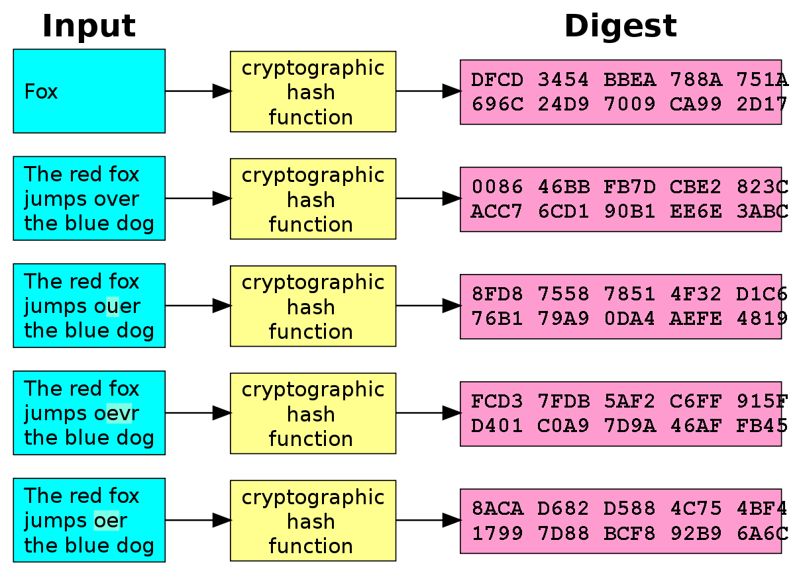
Hashing with salt
One directional
One simple non-cryptographic hash function is the modulo (remainder) operator
Avalanche effect – one bit change can result in a significant change in the resulting hash
Add salt to protect against rainbow table attacks*
Available cryptographic hashing algorithms:
MD5
SHA1
SHA256
* Rainbow tables: pre-computed table of password hash chains used to crack hashed passwords

Slide 49
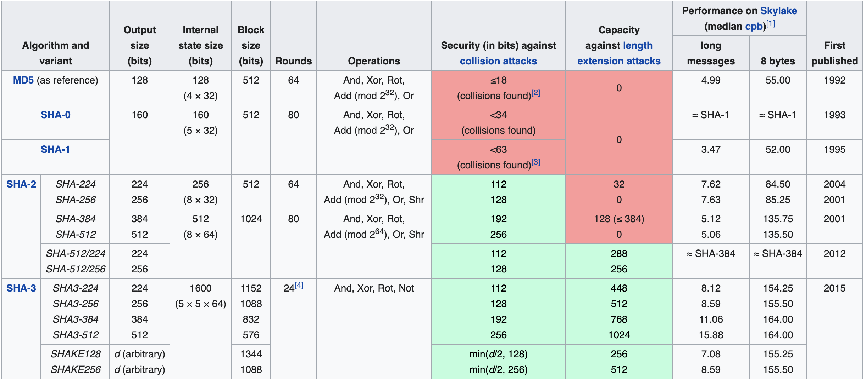
Hashing algorithms at a glance
n-bit security means that the attacker would have to perform 2^{n} operations to break it

Slide 50
T7 – Hashing with salt
Code Demo

Slide 51

T8 – Tokenization*
What:
Ensure that identifiers cannot be seen in the event of a compromise
Why:
This ensures that even if an attacker were to break into the IT system, the data would be unusable to the attacker.
How:
Replace identifiers and attributes with a different value known only to the agency. The different values are randomly generated and saved in a lookup table/token vault
*Note: the underlying technique of field-level encryption achieves the same function as “T9. Field Level Encryption”.
This technique is appropriate for data fields where the actual values need to be recovered, such as identifiers required for service delivery

Slide 52
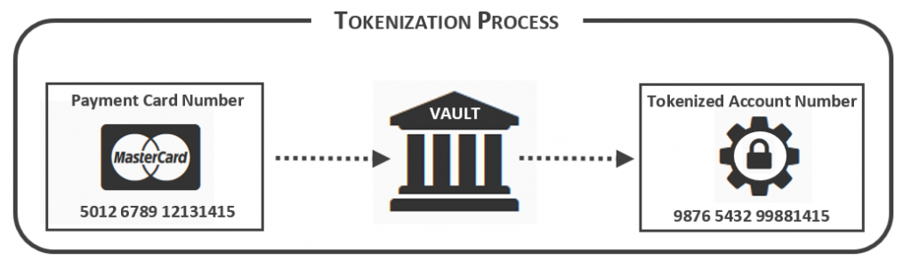
Tokenization
Randomly generates a token value for each original value and store the mapping in a token vault

Slide 53
T8 – Tokenization
Code Demo

Slide 54
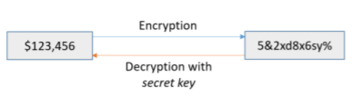
T9 – Field-level encryption*
What:
Ensure that sensitive values cannot be seen in the event of a compromise
Why:
This ensures that even if an attacker were to break into the IT system, the data would be unusable to the attacker.
How:
Encrypting specific data fields to hide the true value. A different secret encryption key is to be used for each field.
*Note: the underlying technique of field-level encryption achieves the same function as “T8. Tokenisation”.
The technical implementation of field-level encryption uses a mathematical encryption function instead of a lookup table for tokenisation. Field-level encryption is more appropriate where the actual values need to be frequently recovered. (e.g. deidentification of data set is required by other agencies as part of their BAU usage, de-tokenization will be too slow for such a purpose, instead the field is encrypted at rest but decrypted when accessing it)

Slide 55
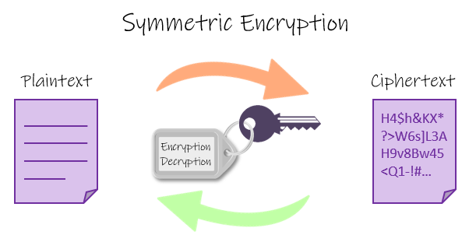
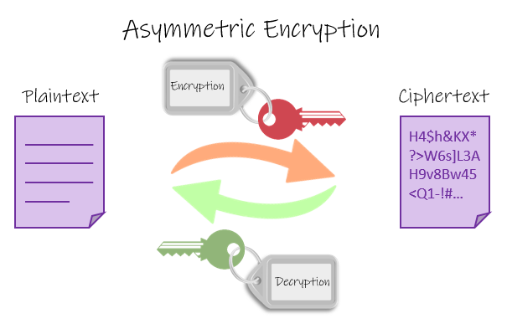
Encryption basics
Two way functions (i.e. can encrypt and decrypt)
Symmetric
Only 1 key which does both encryption and decryption
E.g. AES
Asymmetric
2 keys (a.k.a keypairs), when one is used for encryption only the other key can be used to decrypt the data
E.g. RSA algorithm

Slide 56
T9 – Field-level encryption (symmetric key)
Code Demo

Slide 57
P8 – Manage keys to data protection technical safeguards
What:
Ensure the effectiveness of the technical safeguards of tokenisation and field-level encryption by keeping the “key” safe
Why:
This ensures that even if an attacker were to break into the IT system, the data would be unusable to the attacker.
How:
Implement processes to ensure that the officer holding the key is not the same person as the officer using the data.

Slide 58

T10 – Obfuscation/ masking/ removal of entity attributes*
What:
Ensure that the exact sensitive values cannot be seen or ever recovered in the event of a compromise, although approximate or noisy values might still be seen.
Why:
This ensures that even if an attacker were to break into the IT system, the damage would be limited as he/she would have no access to the full data.
How:
Hide the true value of the attributes by adding noise, banding the data, or masking out portions of the value. Attributes not relevant for data usage should be removed.
*Note: This measure is appropriate where the exact values are sensitive, but noisy values (that are less sensitive) are sufficient for usage and exploitation.

Slide 59
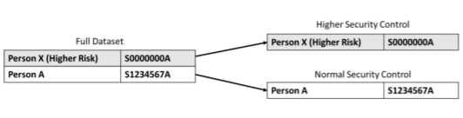
T11 – Dataset partitioning
What:
Ensure that information on selected entities or attributes will not be compromised even if the larger database has been compromised. This could include individuals in vulnerable positions or sensitive attributes.
Why:
This ensures that even if an attacker were to break into the IT system, the damage would be limited as he/she would have no access to the full data.
How:
Break a dataset into smaller datasets by segmenting out selected entities or attributes and apply different access controls to each of the partitions.
The partitioning of the dataset can be achieved by either: (a) physically partitioning of the dataset in different storage locations; or (b) virtually partitioning of the datasets in different virtually isolated partitions. Each dataset partition, physical or virtual, would have different access controls.

Slide 60
T12 – Password protecting and encrypting files
What:
Ensure that only the receiver with the password can access the file.
Why:
Another common source of data incidents is when a public officer mistakenly distributes the data file to unauthorised parties, for example, via email. An unauthorised party could also intercept the data during transit. Data must therefore be protected during the distribution phase as well.
How:
Secure a file using encryption and password such that only authorised users can access and change the content.

Slide 61
P9 – Securely distribute passwords out-of-band
What:
Ensure the effectiveness of the technical safeguards of password protecting and encrypting files by sending the passwords to secured files via a separate message on a different channel.
Why:
Another common source of data incidents is when a public officer mistakenly distributes the data file to unauthorised parties, for example, via email. An unauthorised party could also intercept the data during transit. Data must therefore be protected during the distribution phase as well.
If the password was sent together with the email, the unauthorised party would have access to the underlying dataset.
How:
Password to encrypted file is transmitted through a different channel, such as through text or call or trusted Instant Messaging services.

Slide 62
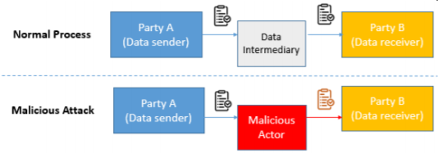
T13 – Data file integrity verification
What:
Ensure that the receiver gets the same file that the original sender intended.
Why:
This measure allows the recipient to verify that the data is the same as what the sender has sent, and protects such data against malicious attacks.
How:
Original data sender provides a checksum or digital signature that confirms the integrity of a data file.

Slide 63
File integrity verification with Asymmetric Key Encryption (Public Key Cryptography)
What is public key cryptography?
A cryptographic system that uses asymmetric key encryption algorithm to:
Ensure that only the intended recipient can decrypt the file/message
Ensure that the file/message is sent by the correct sender
Ensure that the file/message is not corrupted or tampered with (i.e. File integrity verification)
Recap on what is asymmetric key encryption:
Encryption keys come in pairs
When one key is used to encrypt, only the other key can be used to decrypt (and vice versa)
In public key cryptography, one key would be a private key (known only to the owner) and the other will be a public key (known to everyone)

Slide 64


File integrity verification with Asymmetric Key Encryption (Public Key Cryptography)
Feature 1:
Ensure that only the intended recipient can decrypt the file/message
Encrypt with recipient public key
Decrypt with recipient private key
Sender
In transit
Recipient
Plaintext
message
Encrypted
message
Plaintext
message

Slide 65

File integrity verification with Asymmetric Key Encryption (Public Key Cryptography)
Feature 2:
Ensure that message is not corrupted or tampered with
Encrypt with recipient public key
Decrypt with recipient private key
Sender
In transit
Recipient
Plaintext
message
Encrypted
message
Plaintext
message
Hashing algorithm (e.g. MD5, SHA1, etc.)
Same hashing algorithm
Sender message digest
Sender message digest
Recomputed message digest
Compare hash digests

Slide 66


File integrity verification with Asymmetric Key Encryption (Public Key Cryptography)
Feature 3:
Ensure that file is received from correct sender
Encrypt with recipient’s public key
Decrypt with recipient’ private key
Sender
In transit
Recipient
Plaintext
message
Encrypted
message
Plaintext
message
Hashing algorithm (e.g. MD5, SHA1, etc.)
Same hashing algorithm
Sign with sender’s private key
Validate signature using sender’s public key
Sender message digest
Signed sender message digest
Validated Sender message digest
Recomputed message digest
Compare hash digests

Slide 67
T13 – Data file integrity verification
Code Demo

Slide 68
P10 – Distribute files through appropriate secure channels
What:
Ensure that the distribution channels for sensitive files have the appropriate security safeguards.
Why:
To protect data during the distribution phase from being intercepted.
How:
The distribution channel that the officer uses should encrypt the file during transmission so that any attacker who maliciously intercepts the file would not be able to retrieve the original contents. (e.g. using HTTPS, SFTP, etc.)

Slide 69

Quiz time

Slide 70
Data Anonymization Concepts and Methods

Slide 71
Data Anonymization Concepts and Methods
Techniques specified in PSDSRC 2019
Hashing with salt
Tokenization
Encryption (Symmetric/Asymmetric)
Obfuscation/Data Masking
Concepts
K-Anonymity
Differential Privacy
Techniques not explicitly specified in PSDSRC 2019
Format Preserving Encryption
Synthetic Data
Homomorphic encryption
Data Perturbation
Generalization
Data Swapping
Secure multiparty compute

Slide 72
Concepts

Slide 73
K-Anonymity
Definition:
k-anonymity is a property possessed by certain anonymized data where for k-anonymity to be achieved, there need to be at least k individuals in the dataset who share the set of attributes that might become identifying for each individual.
Ways of achieving k-anonymity:
Generalization:
replace quasi-identifiers* with less specific, but semantically consistent values until get k identical values and partition ordered-value domains into intervals.
Suppression:
when generalization causes too much information loss then the quasi-identifier is omitted, not released at all. This is common with outliers.
*quasi-identifiers: indirect identifiers like gender, religion, postal code, birthday

Slide 74
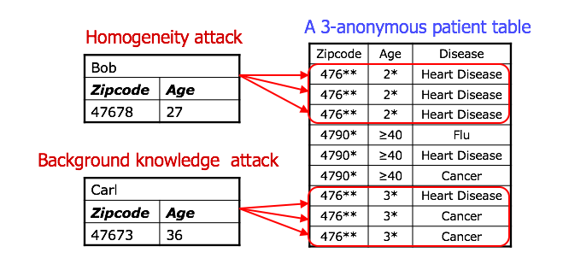
K-Anonymity
Attacks on K-Anonymity:
Homogeneity Attack:
This attack leverages the case where all the values for a sensitive value within a set of k records are identical. In such cases, even though the data has been k-anonymized, the sensitive value for the set of k records may be exactly predicted.
Background Knowledge Attack:
This attack leverages an association between one or more quasi-identifier attributes with the sensitive attribute to reduce the set of possible values for the sensitive attribute.

Slide 75
Differential privacy (ϵ)
Definition:
Differential privacy in itself is not a technology. It’s a property that describes some systems — a mathematical guarantee that your privacy won’t be violated if your data are used for analysis. A system that is differentially private allows analysis while protecting sensitive data behind a veil of uncertainty.
Measurement
ϵ is a measure of how private, and how noisy, a data release is. Higher values of ϵ indicate more accurate, less private answers; low-ϵ systems give highly random answers that don’t let would-be attackers learn much at all.
There’s not much consensus about what values of ϵ are actually “private enough.” Most experts agree that:
values between 0 and 1 are very good,
values above 10 are not,
and values between 1 and 10 are various degrees of “better than nothing.”
The parameter ϵ is exponential: by one measure, a system with ϵ = 1 is almost three times more private than ϵ = 2, and over 8,000 times more private than ϵ = 10.

Slide 76
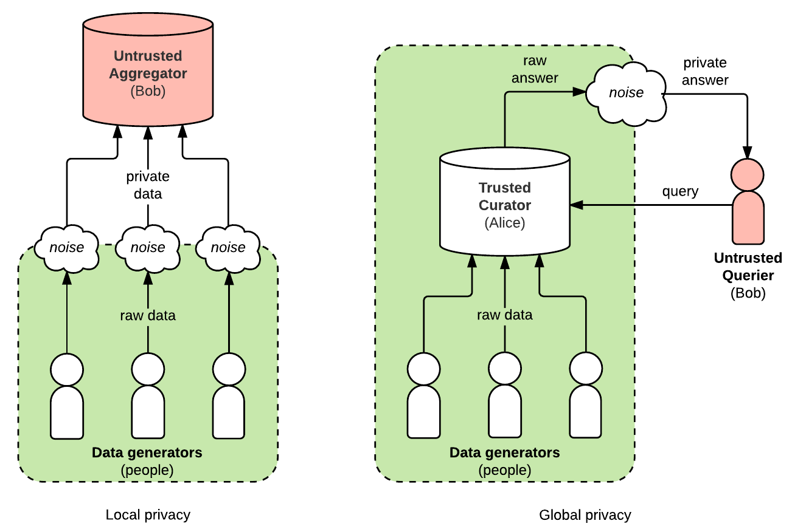
Differential privacy
Ways of achieving ϵ differential privacy:
Global:
In a globally private system, one trusted party (or curator) has access to raw, private data from lots of different people. The curator does analysis on the raw data and adds noise to answers after the fact.
Local:
With local privacy, there is no trusted party; each person is responsible for adding noise to their own data before they share it.

Slide 77
Other techniques not explicitly specified in PSDSRC 2019

Slide 78
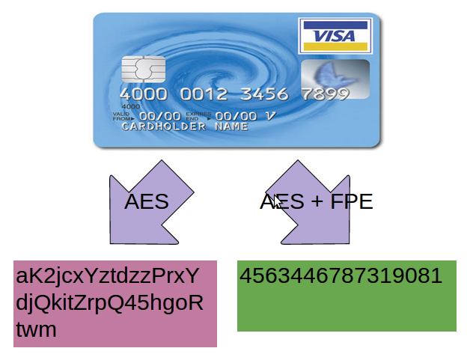
Format Preserving Encryption (FPE)
Some systems are not able to accept the format of encrypted ciphertext and can only store data in the same format as the plain text
FPE is a technique which convert the ciphertext into the same format as the plain text

Slide 79
Format Preserving Encryption (FPE)
Code Demo

Slide 80
Synthetic Data Generation
Definition:
Synthetic dataset is a repository of data that is generated programmatically that attempts to model the original data but at the same time preserve privacy. This allows data mining to be done but with reduced risk of sacrificing privacy.
Categories:
Fully synthetic:
Fully synthetic data generators identify the density function of attributes in the original data and estimate the parameters of these density functions. Then for each attribute, privacy protected series are generated by randomly picking up the values from the estimated density functions.
Partially synthetic:
Partially synthetic data generators replaces only values of the selected sensitive attribute with synthetic values. The original values are replaces only if it posses high risk of disclosure. Masking the original values with synthetic values prevents re-identification thus preserving privacy in the published data.

Slide 81
Synthetic Data Generation
Code Demo

Slide 82
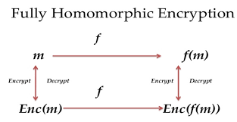
Homomorphic encryption
The purpose of homomorphic encryption is to allow computation on encrypted data.
Thus data can remain confidential while it is processed, enabling useful tasks to be accomplished with data residing in untrusted environments.
Example of Partially Homomorphic Encryption is the RSA algorithm where addition and multiplication could be done
One of the recent Full Homomorphic Encryption is CKKS which supports rounding operations and is intended to be used for encrypted machine learning

Slide 83
Homomorphic encryption
Code Demo

Slide 84
Data Perturbation
Definition:
Data perturbation is a data security technique that adds ‘noise’ to databases allowing individual record confidentiality.
Categories:
Probability distribution perturbation:
considers the selected data and replaces it from the same distribution sample or from the distribution itself
Value distortion perturbation :
perturbs data by multiplicative or additive noise, or other randomized processes

Slide 85
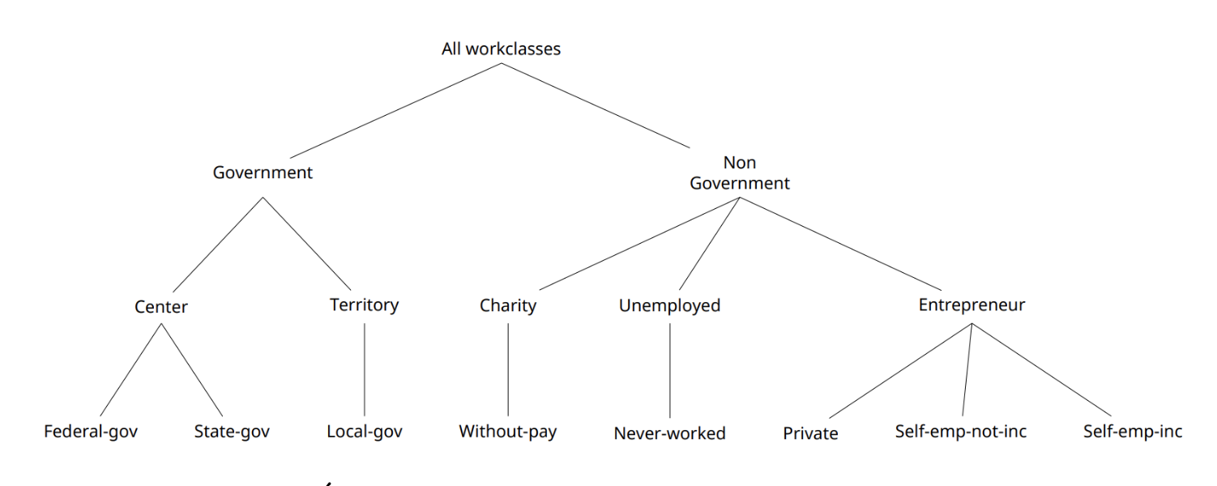
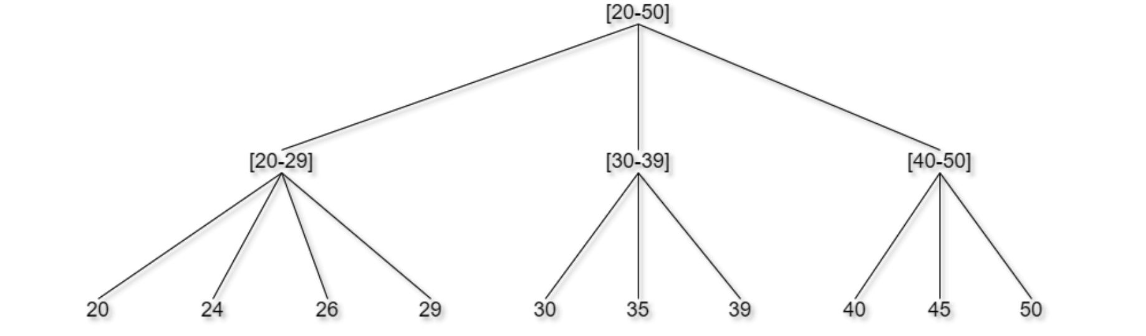
Generalization
replace a data value with a less precise one via binning, reformatting, rounding or truncating, which preserves data utility and protects against linkage attacks*
*linkage attacks: adversaries collect auxiliary information about a certain individual from multiple data sources and then combine that data to form a whole picture about their target, which is often an individual’s personally identifiable information.

Slide 86
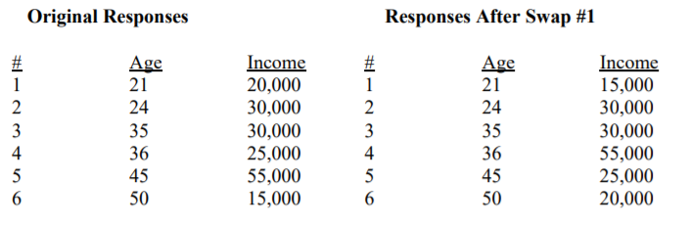
Data swapping
interchanging values of individual records so that removes the relationship between the record and the respondent while still preserving some of the statistical frequency counts

Slide 87
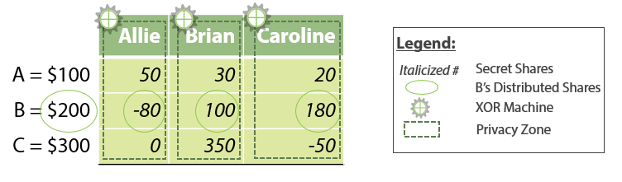
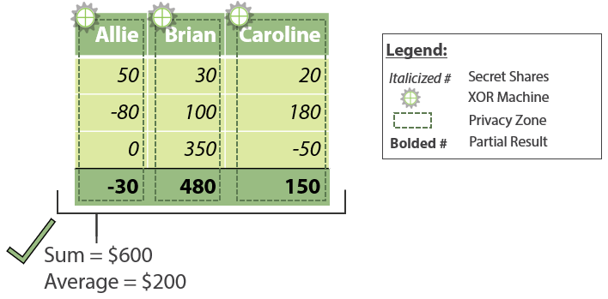
Secure Multiparty Compute
Secure multiparty computation (MPC / SMPC) is a cryptographic protocol that distributes a computation across multiple parties where no individual party can see the other parties’ data.
In this simplified example (right), Allie, Brian and Caroline’s salaries are $100, $200 and $300 respectively. These are then broken down and distributed to 3 separate secret shares held by Allie, Brian and Caroline respectively.
When held separately, the numbers are not useful, but when added up, it becomes useful.

Slide 88
Summary
Data is the lifeblood of the digital economy and a digital government.
Data privacy is an enabler that allows us to use and share data as fully as possible to provide better public services.
When in doubt, do check the relevant policies in the IM8 and obligations in the PDPA.

Slide 89


Questions?

